Slide 1
Metabolic Acidosis

Slide 2
Metabolic acidosis is a clinical disturbance characterized by an increase in plasma acidity.
Metabolic acidosis should be considered a sign of an underlying disease process.
Metabolic acidosis occurs when acid is added to the body or when alkali is lost from the body.
Identification of this underlying condition is essential to initiate appropriate therapy.

Slide 3
Etiology
Metabolic acidosis is typically classified as having a normal AG (ie, non-AG) or a high AG.
Non-AG metabolic acidosis is also characterized by hyperchloremia and is sometimes referred to as hyperchloremic acidosis.
Hyperchloremic or non-AG metabolic acidosis occurs principally when HCO3- is lost from either the GI tract or the kidneys or because of a renal acidification defect.
A metabolic acidosis can be caused by three major mechanisms:
1) increased acid production;
2) bicarbonate loss; and
3) decreased renal acid excretion

Slide 4
Classification
A. Metabolic acidosis with high anion gap
Renal causes –
Uremic acidosis due to accumulation of uremic anions occurs when the GFR is < 20 mL/ min.
ii. Extra-renal causes
a. Accumulation of lactic acid - (due to incomplete carbohydrate oxidation) lactic acidosis, e.g. shock, sepsis, cirrhosis, malignancies, phenformin and very rarely metformin.
b. Accumulation of ketoacids due to incomplete oxidation of fat, e.g. diabetic ketoacidosis, starvation ketoacidosis, alcoholic ketoacidosis.
c. Poisoning, e.g. ethylene glycol, methanol, ethanol, isopropyl alcohol, salicylate.
d. Gain of exogenous acid, e.g. hydrochloric acid, ammonium chloride, methionine and intravenous hyperalimentation.

Slide 5
B. Metabolic acidosis with normal anion gap
i. Renal causes:
Proximal renal tubular acidosis (Type II RTA).
Distal renal tubular acidosis (Type I RTA).
Hyperkalemic distal RTA (Type IV RTA).
Chronic kidney disease with mild renal insufficiency.
ii. Extrarenal causes:
Diarrhea (loss of bicarbonate).
Pancreatic/biliary fistula (loss of bicarbonate).
Uretero sigmoidostomy leading to reabsorption of H+ ions and ammonia in exchange for bicarbonate in the gut.
Use of cholestyramine.

Slide 6
Clinical Features
Symptoms of metabolic acidosis are not specific.
The respiratory center in the brainstem is stimulated, and hyperventilation develops in an effort to compensate for the acidosis.
As a result, In mild degrees of acidosis, increase in respiratory rate and in severe acidosis, deep sighing respiration (Kussmaul’s breathing) occurs.
Patients may also report chest pain, palpitations, headache, confusion, generalized weakness, and bone pain.
Patients, especially children, also may present with nausea, vomiting, and decreased appetite.

Slide 7
The clinical history in metabolic acidosis is helpful in establishing the etiology when symptoms relate to the underlying disorder.
The age of onset and a family history of acidosis may point to inherited disorders.
Physical Examination
The best recognized sign of metabolic acidosis is Kussmaul respirations, a form of hyperventilation that serves to increase minute ventilatory volume.
This is characterized by an increase in tidal volume rather than respiratory rate and is appreciated as deliberate, slow, deep breathing.
Chronic metabolic acidosis in children may be associated with stunted growth and rickets.

Slide 8
Coma and hypotension have been reported with acute severe metabolic acidosis.
Other physical signs of metabolic acidosis are not specific and depend on the underlying cause.
Some examples include xerosis, scratch marks on the skin, pallor, drowsiness, fetor, asterixis, and pericardial rub for renal failure, as well as reduced skin turgor, dry mucous membranes, and fruity smell for DKA.

Slide 9
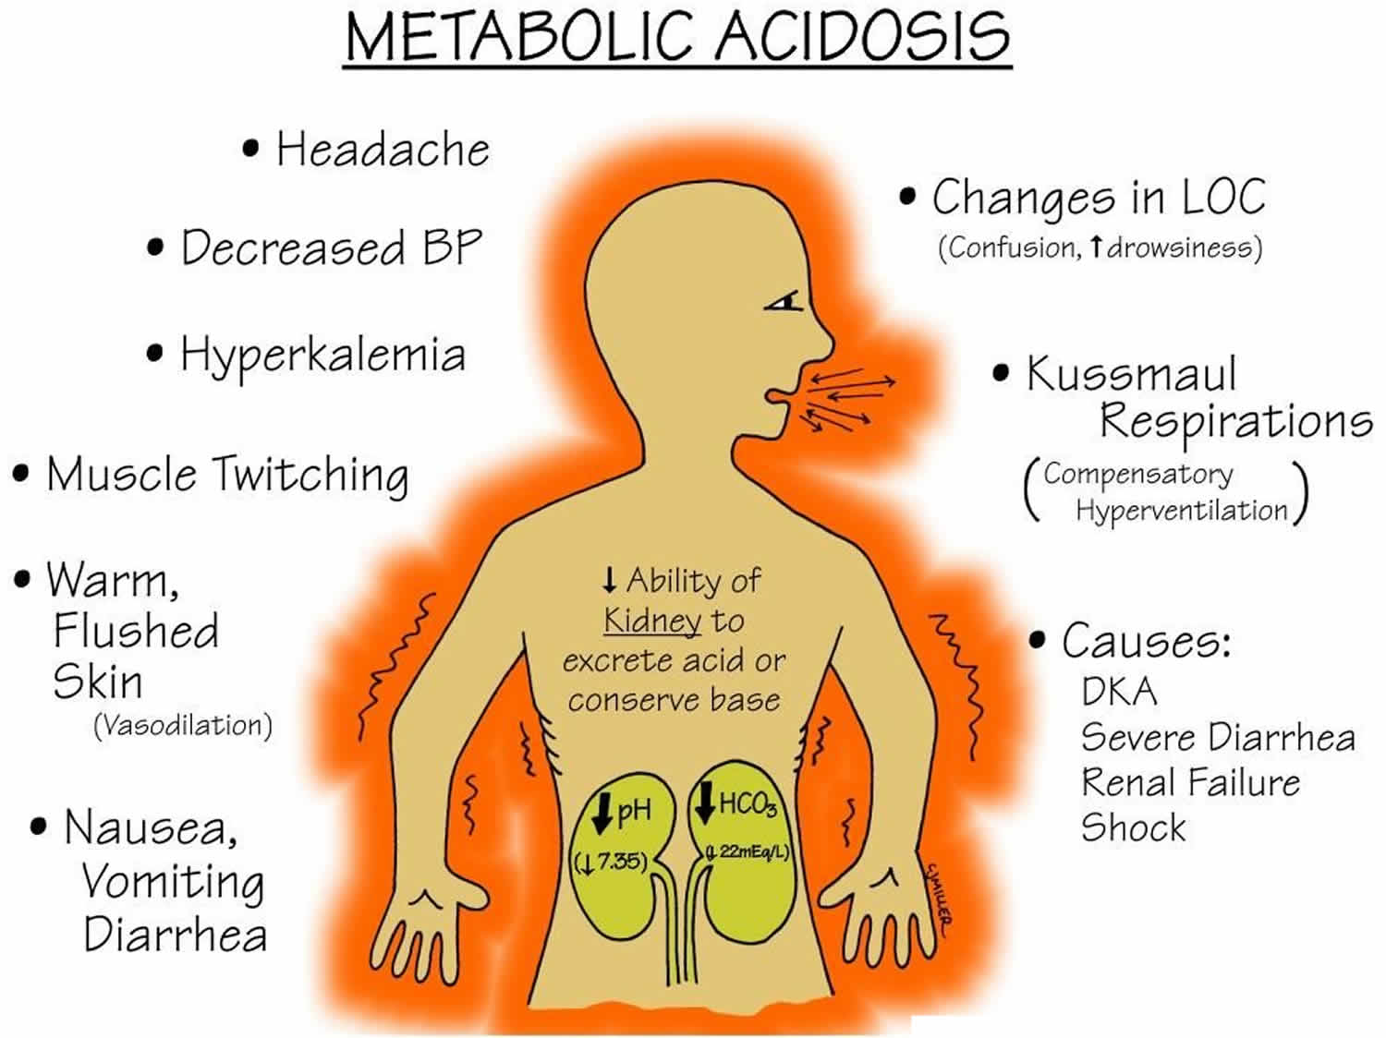
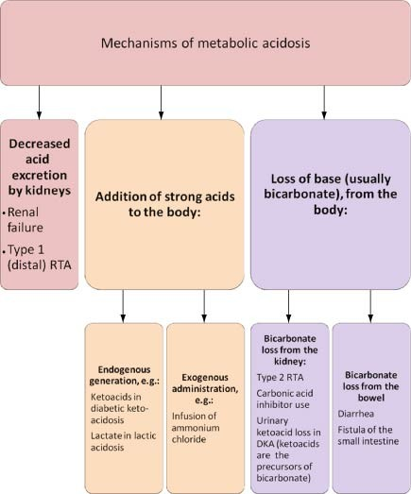

Slide 10
Diagnosis
Arterial blood gas (ABG) and serum electrolyte measurement
Anion gap and delta gap calculated
Winters formula for calculating compensatory changes
Testing for cause

Slide 11
Management
Management depends on the correction of the underlying disorder.
Correction with IV sodium bicarbonate is indicated if acidosis is symptomatic and severe (pH < 7.2 and HCO3 < 12).
Bicarbonate required = 0.3 × bodyweight in Kg × deficit.
The deficit is calculated by noting the difference between required HCO3 (usually 12 to 16) and observed bicarbonate (available lab value).
The correction is achieved within 2 to 4 hours and ABG is repeated.
In high anion gap metabolic acidosis due to intoxications, removal of the toxins by appropriate measures may be undertaken.

Slide 12
Metabolic Alkalosis

Slide 13
Metabolic alkalosis is common, comprising half of all the acid–base disorders in hospitalized patients.
This observation should not be surprising since vomiting, the use of diuretics, and nasogastric suction are common among hospitalized patients.
The mortality associated with metabolic alkalosis is substantial; the mortality rate is 45% in patients with an arterial pH of 7.55 and 80% when the pH is >7.65.
Metabolic alkalosis is primary increase in bicarbonate (HCO3−) with or without compensatory increase in carbon dioxide partial pressure (Pco2); pH may be high or nearly normal.

Slide 14
Metabolic alkalosis is due either to a gain in bicarbonate or a bicarbonate precursor (HCO₃–), loss of hydrogen ion (H⁺) or the loss of fluid that contains Cl– in higher concentration and bicarbonate in lower concentration than serum.
The brainstem is sensitive to interstitial and cellular H⁺changes and the decline in H⁺ with metabolic alkalosis inhibits ventilation (respiratory compensation).
Alkalosis will be sustained only if renal functions are markedly reduced or alkali loading is very high.

Slide 15
There are three kinds of metabolic alkalosis:
Chloride-responsive alkalosis results from loss of hydrogen ions, usually by vomiting or dehydration.
Chloride-resistant alkalosis results when your body retains too many bicarbonate (alkaline) ions, or when there’s a shift of hydrogen ions from blood to cells.
and
Miscellaneous.

Slide 16
Chloride responsive metabolic alkalosis
a. Gastric acid loss
i. Vomiting
ii. Gastric drainage
iii. Pyloric stenosis
b. Urinary loss—Diuretic therapy
c. Fecal loss—Congenital chloride diarrhea, villous adenoma of colon
d. Recovery from chronic hypercapnia

Slide 17
B. Chloride resistant metabolic alkalosis
a. Hyperaldosteronism
i. Conn’s syndrome
ii. Cushing’s syndrome
iii. Bartter’s syndrome
iv. Liddle’s syndrome
v. Liquorice ingestion

Slide 18
C. Miscellaneous
a. Alkali administration
i. Milk - alkali syndrome
ii. Massive blood transfusion, due to excess of citrate
iii. Alkali supplements
b. Hypercalcemia
c. Poorly absorbable anion administration

Slide 19
Clinical Features
Metabolic alkalosis is generally, well tolerated and patients are not symptomatic.
The symptoms are generally related to hypoxemia, hypokalemia, hypocalcemia and alkalemia.
Symptoms like lethargy, confusion or stupor are often related to hypoxia and hypoventilation, and are particularly worse in those with chronic obstructive airway disease.
The clinical manifestations related to hypokalemia are weakness, ECG changes or even flaccid paralysis.
Tetany may occur due to fall in ionic calcium level.

Slide 20
Diagnosis
The finding of serum bicarbonate of > 30 mmol/L associated with hypokalemia is pathognomonic of metabolic alkalosis.
Since metabolic alkalosis may co-exist with other acid-base disturbances, mixed acid-base disorders should be looked for.
A single measurement of urinary chloride in a spot sample of urine is sufficient to classify if it is chloride responsive or chloride resistant metabolic alkalosis.

